Slide 1
Android Boot Camp for Developers Using Java, 3E
Chapter 2: Simplify! The Android User Interface

Slide 2
Objectives
In this chapter, you learn to:
Develop a user interface using the TextView, ImageView, and Button controls
Add text in strings.xml using the Translations Editor
Create an Android project that includes a Button event
Describe Relative and Linear layouts for the user interface
Create multiple Android Activities
View activities to the Android Manifest file

Slide 3
Objectives (continued)
Add a Java class file
Add line numbers to a code window
Write code using the onCreate method
Display content using the setContentView command
Open a second screen using a Button event handler
Use an OnClickListener to detect user interaction
Launch a second screen using a startActivity method

Slide 4
Objectives (continued)
Correct errors in Java code
Run the completed app in the emulator

Slide 5
Designing an Android App
Designing apps is like constructing a building
The Big Picture
Follow these steps:
Create the user interface (XML layout) for every screen
Create an Activity (Java class) for every screen
Code each Java class with appropriate objects and actions
Test the application in the emulator

Slide 6
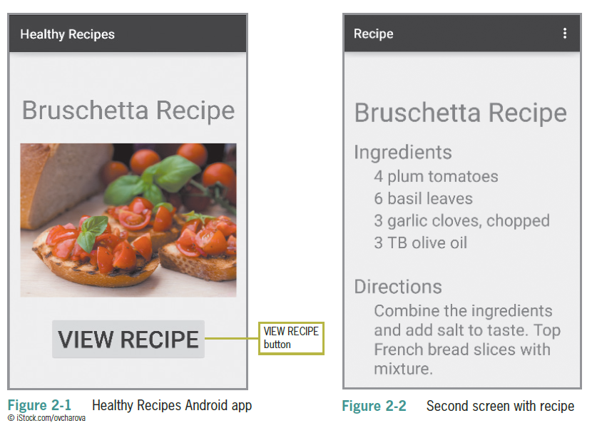
Designing an Android App (continued)

Slide 7
Using the Android User Interface
The interface is a window on the screen of any mobile device
Android apps run on various form factors
The layout is designed with XML code
Special Android-formatted XML code is extremely compact

Slide 8
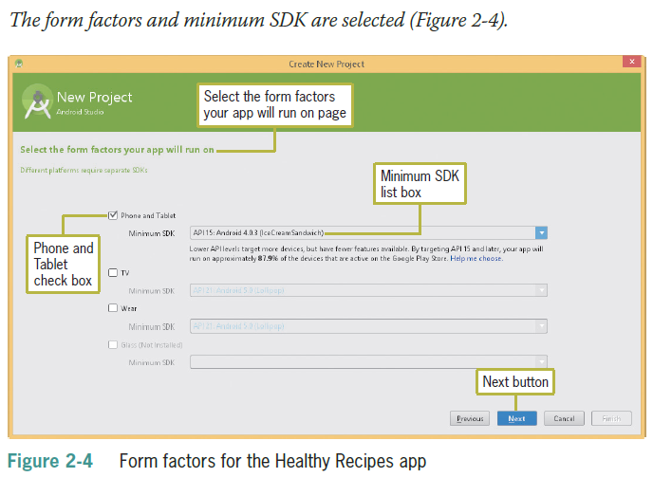
Using the Android User Interface (continued)

Slide 9
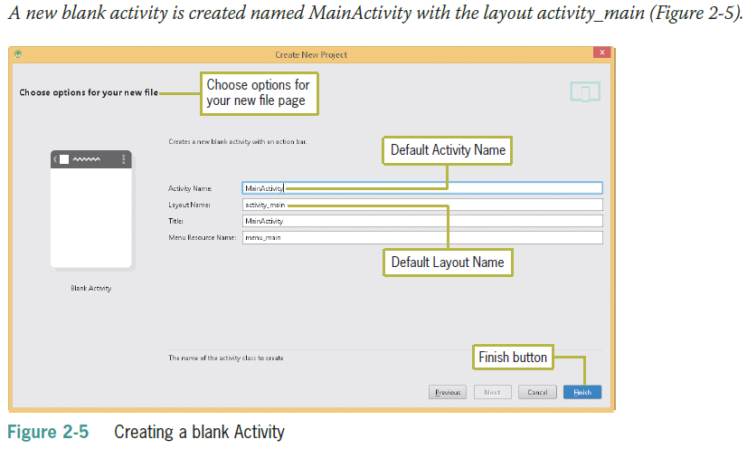
Using the Android User Interface (continued)

Slide 10
Using the String Table in the Translations Editor
strings.xml is a default file that is part of every Android application and contains commonly used strings for an application
Localization is the use of the String table to change text based on the user’s preferred language
Every string is composed of a key, also called the id property, which is the name of a control, and a default value, which is the text associated with the control

Slide 11
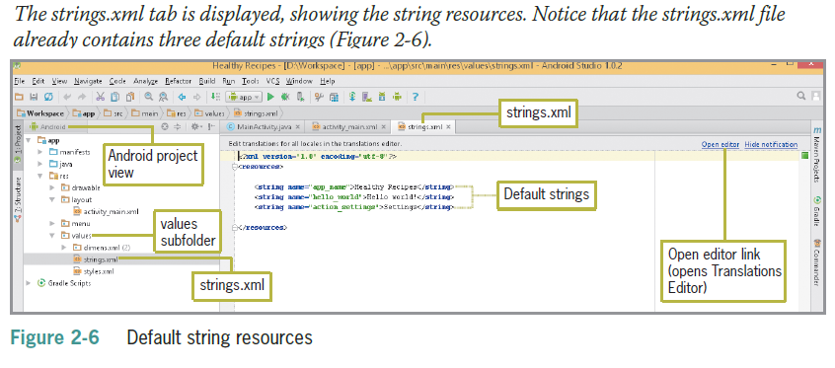
Using the String Table in the Translations Editor (continued)
Notes:
<string name="app_name">Lesson-2</string> <string name="hello_world">Hello Students</string> <string name="action_settings">Settings</string>

Slide 12
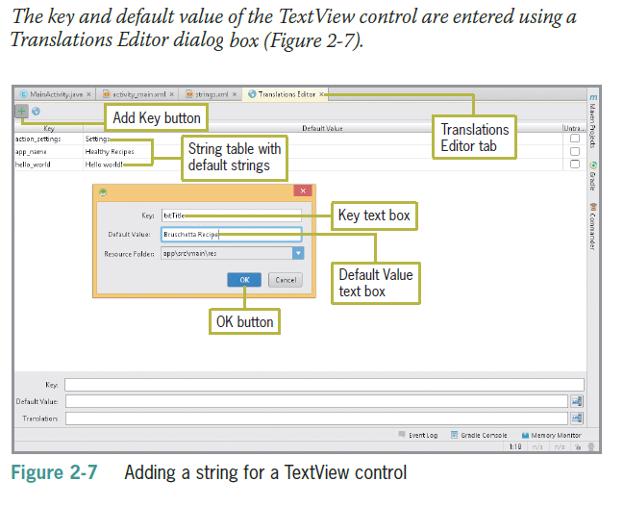
Using the String Table in the Translations Editor (continued)

Slide 13
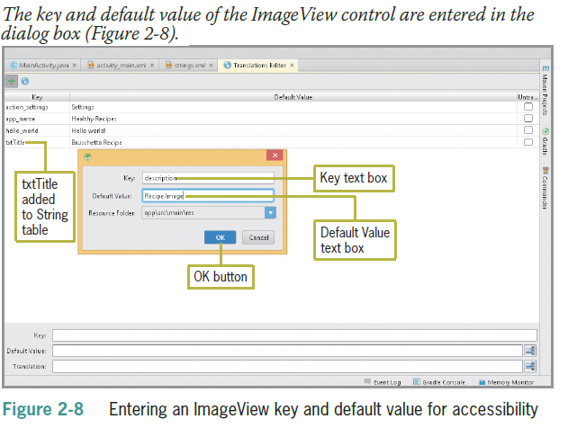
Using the String Table in the Translations Editor (continued)

Slide 14
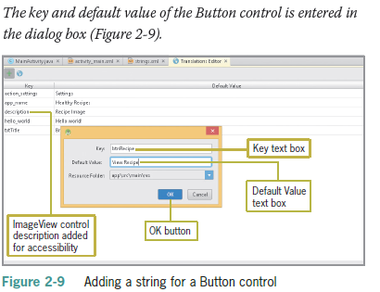
Using the String Table in the Translations Editor (continued)

Slide 15
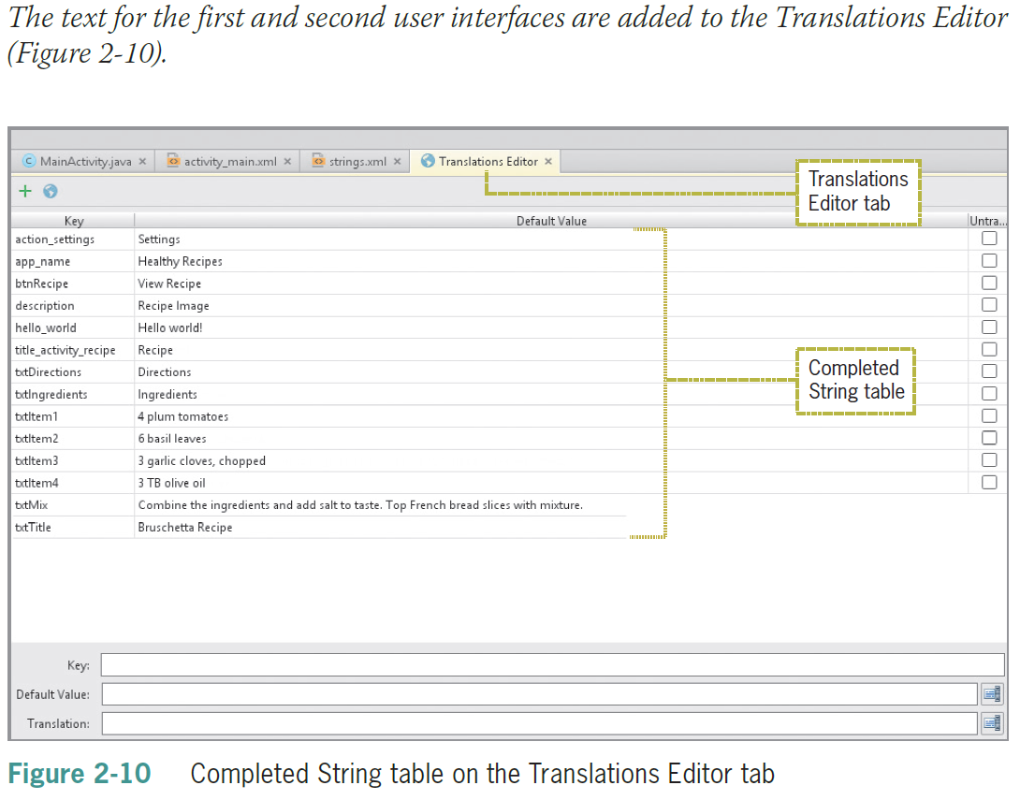
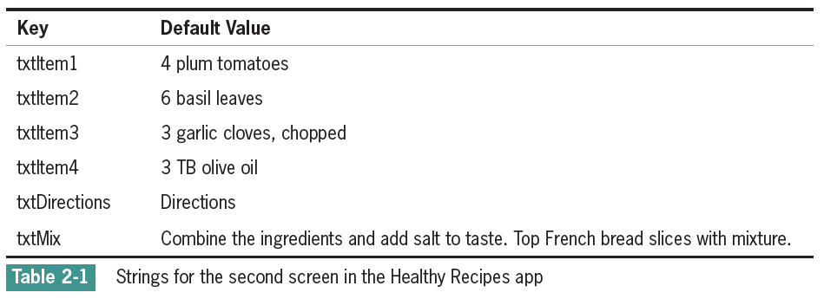
Using the String Table in the Translations Editor (continued)

Slide 16
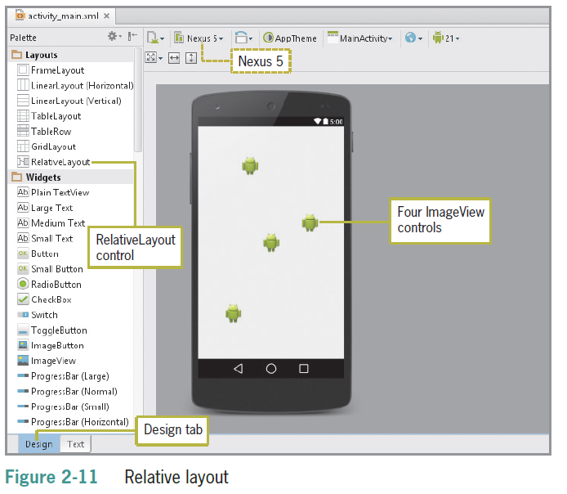
Relative Layouts and Linear Layouts
A Relative Layout organizes layout components in relation to each other
Provides more flexibility in positioning than Linear layouts
Must be changed from the linear default

Slide 17
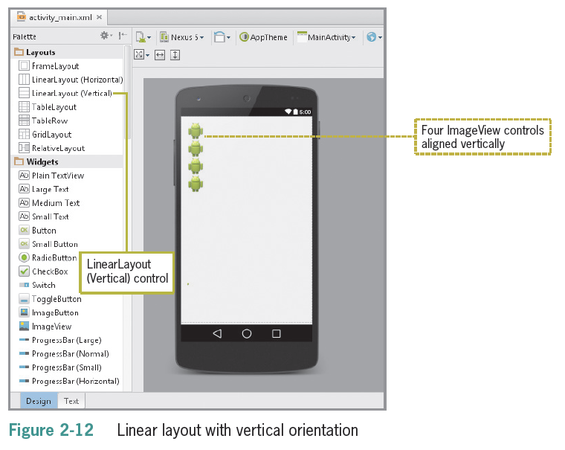
Relative Layouts and Linear Layouts (cont’d)
A Linear Layout organizes layout components in a vertical column or horizontal row
Objects are placed directly below each other
Can be switched from vertical to horizontal orientation
Linear layout is the default layout

Slide 18
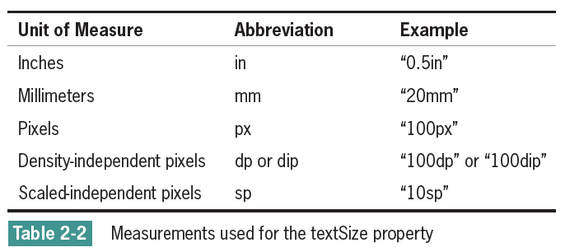
Designing the Healthy Recipes Opening User Interface
The text property uses text from a string resource to display within the control.
The textSize property can use various units of measurement, as shown below
The preferred unit of measurement is often sp, which stands for scaled-independent pixels

Slide 19
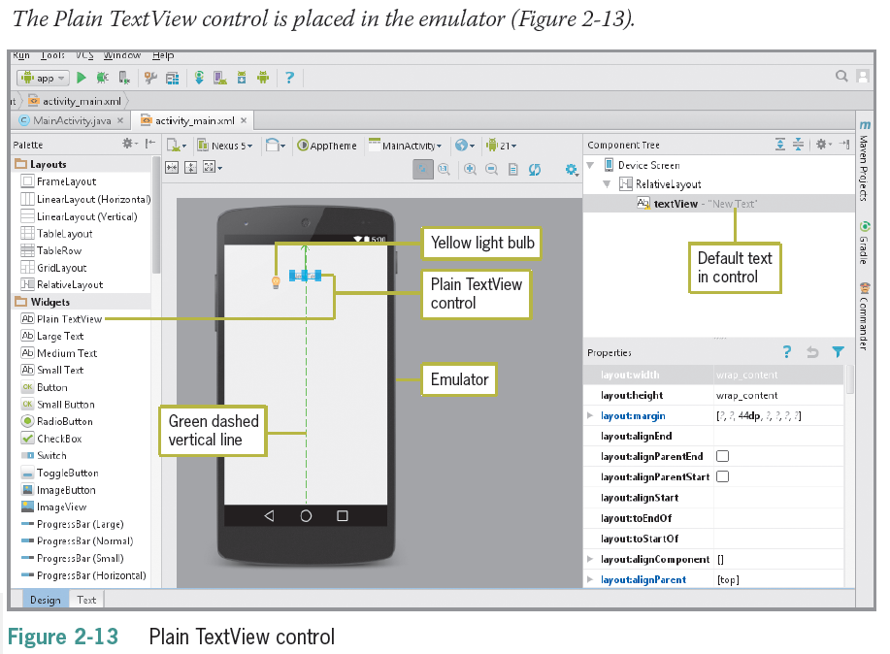
Designing the Healthy Recipes Opening User Interface (cont’d)

Slide 20
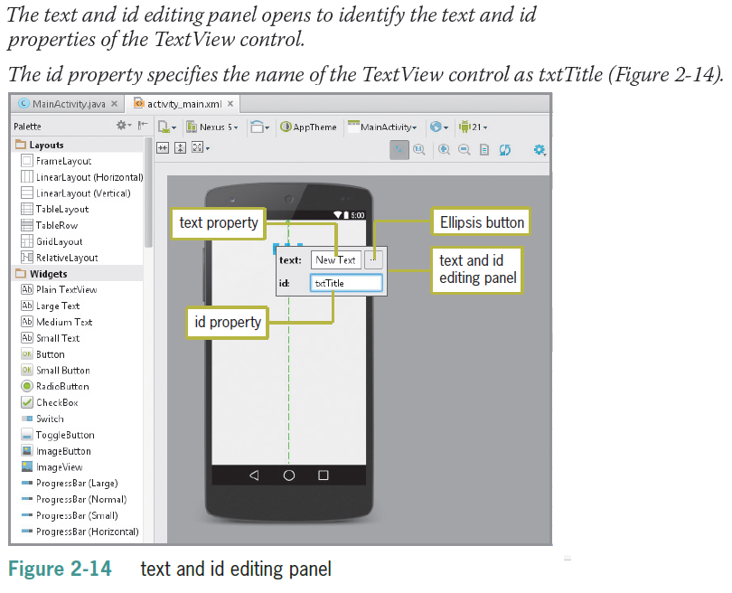
Designing the Healthy Recipes Opening User Interface (cont’d)

Slide 21
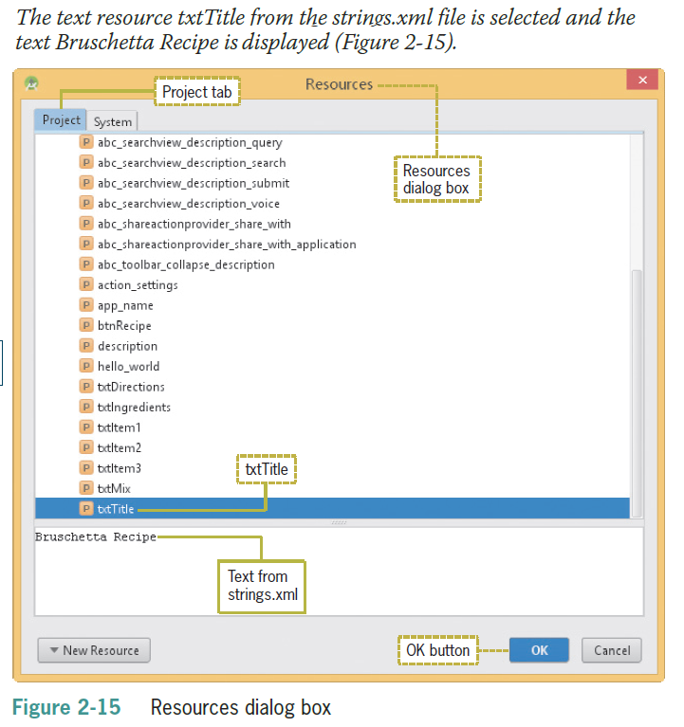
Designing the Healthy Recipes Opening User Interface (cont’d)

Slide 22
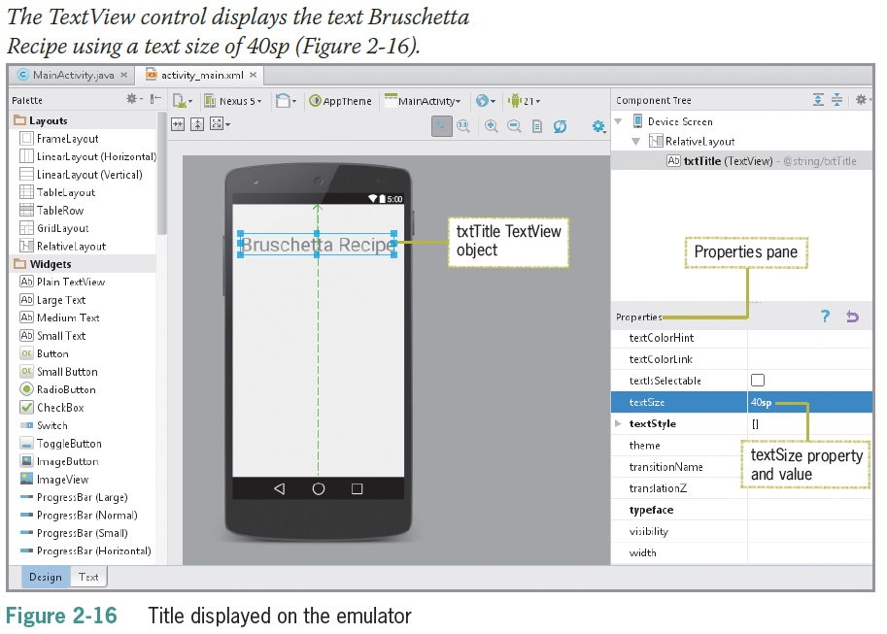
Designing the Healthy Recipes Opening User Interface (cont’d)

Slide 23
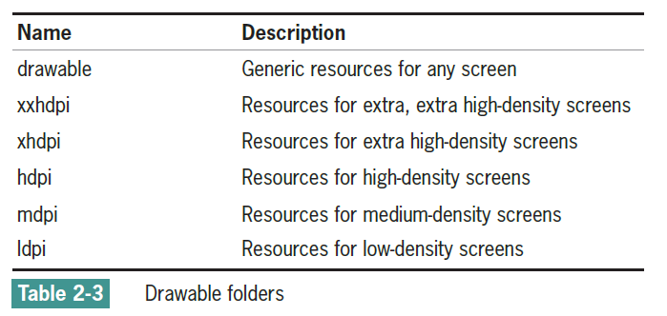
Adding a File to the Resources Folder
Android creates a Drawable resource for any of these images when you save them in the res/drawable folder
Android projects have multiple drawable folders that are named after the resolution of the device
The five drawable folders are identified with the dpi (dots per inch) densities shown in Table 2-3

Slide 24
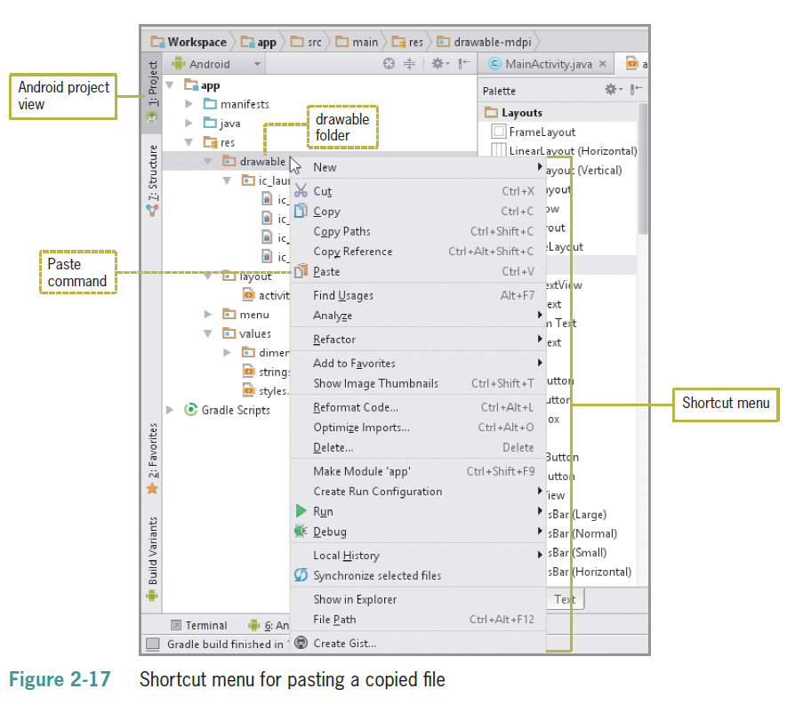
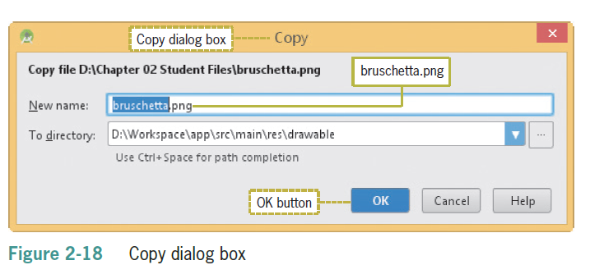
Adding a File to the Resources Folder (cont’d)

Slide 25
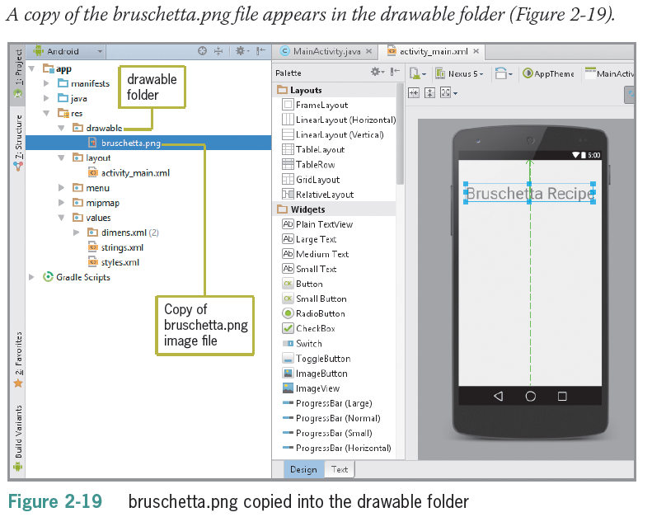
Adding a File to the Resources Folder (cont’d)

Slide 26
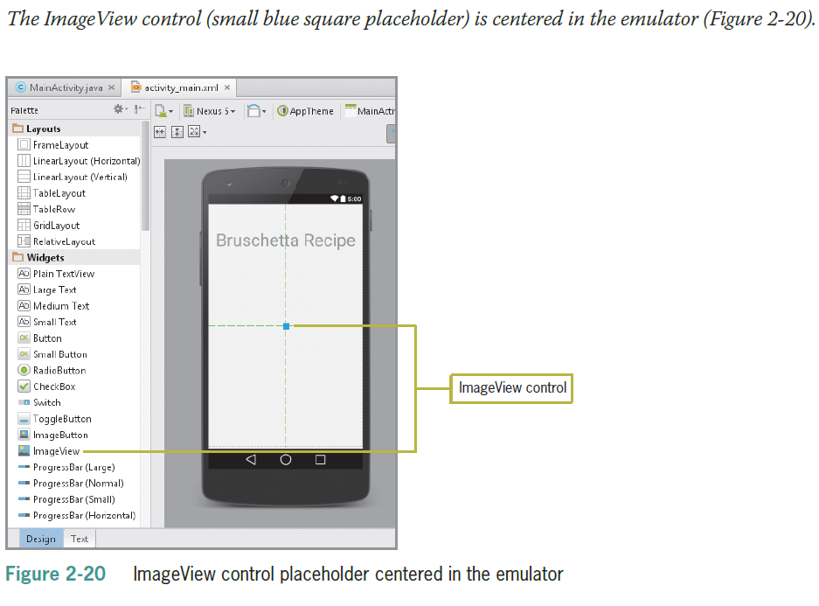
Adding an ImageView Control
An ImageView control displays icons or graphics on the Android screen

Slide 27
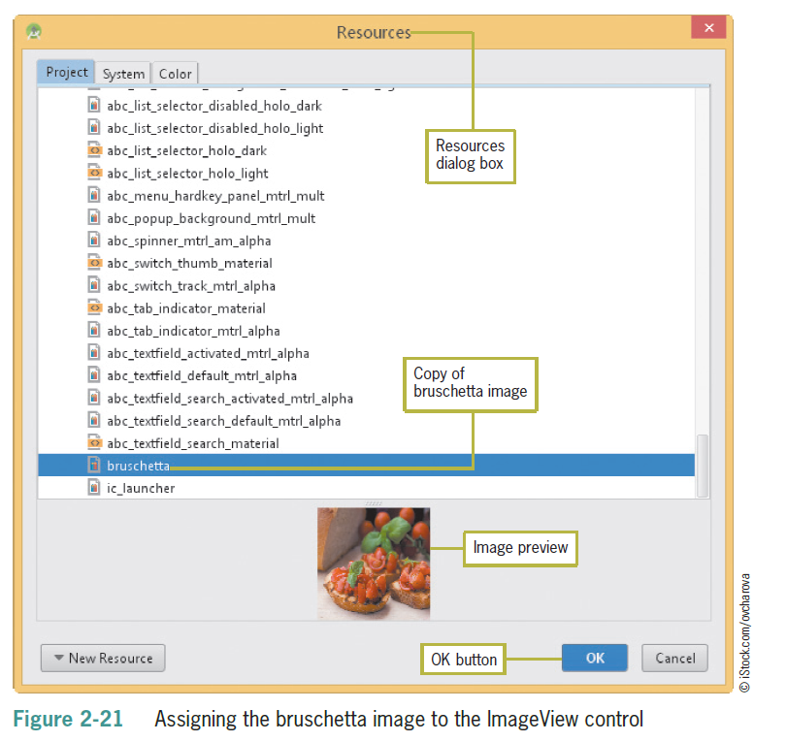
Adding an ImageView Control (continued)

Slide 28
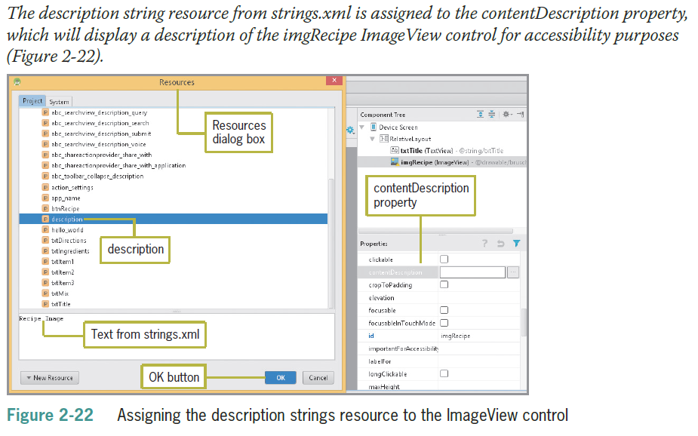
Adding an ImageView Control (continued)

Slide 29
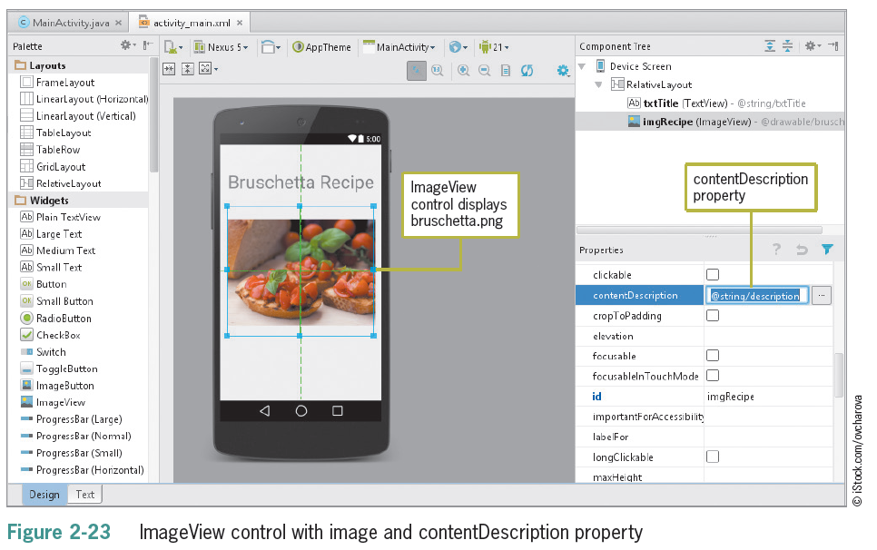
Adding an ImageView Control (continued)

Slide 30
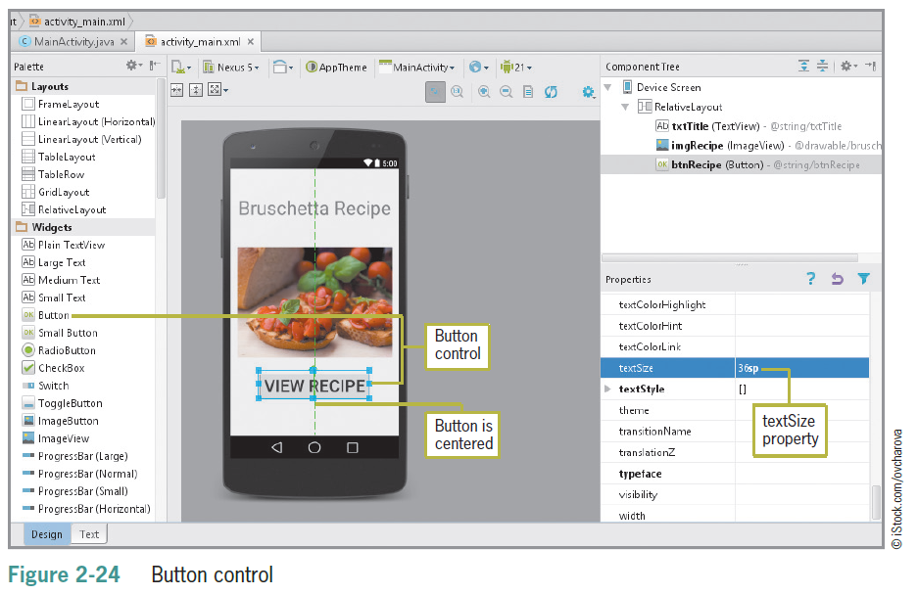
Adding a Button Control
There are four types of Buttons
Button
Small Button
ToggleButton
ImageButton

Slide 31
Creating Activities
Each screen is considered an activity
The point at which the application makes contact with users
Constructed using XML layout files and a Java class
Planning a program
Gather and analyze the program requirements
Design the user interface
Design the program processing objects
Code the program
Test the program

Slide 32
Creating Activities (continued)
Adding a Class File
A class describes a group of objects and serves as a blueprint, or template, for creating those objects
An object is a specific, concrete instance of a class
When you create an object, you instantiate it; meaning you define one particular variation of the object

Slide 33
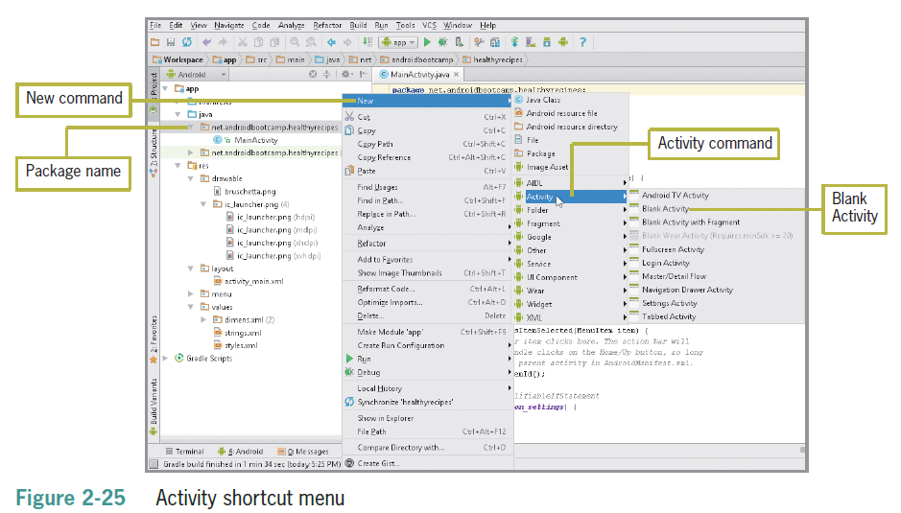
Creating Activities (continued)

Slide 34
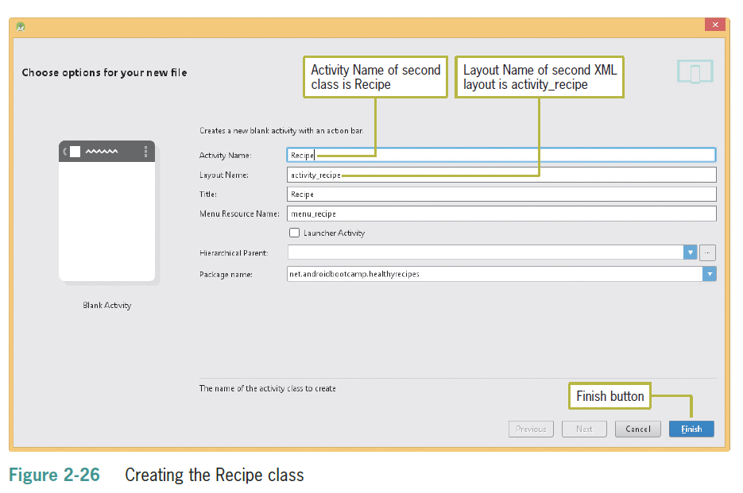
Creating Activities (continued)

Slide 35
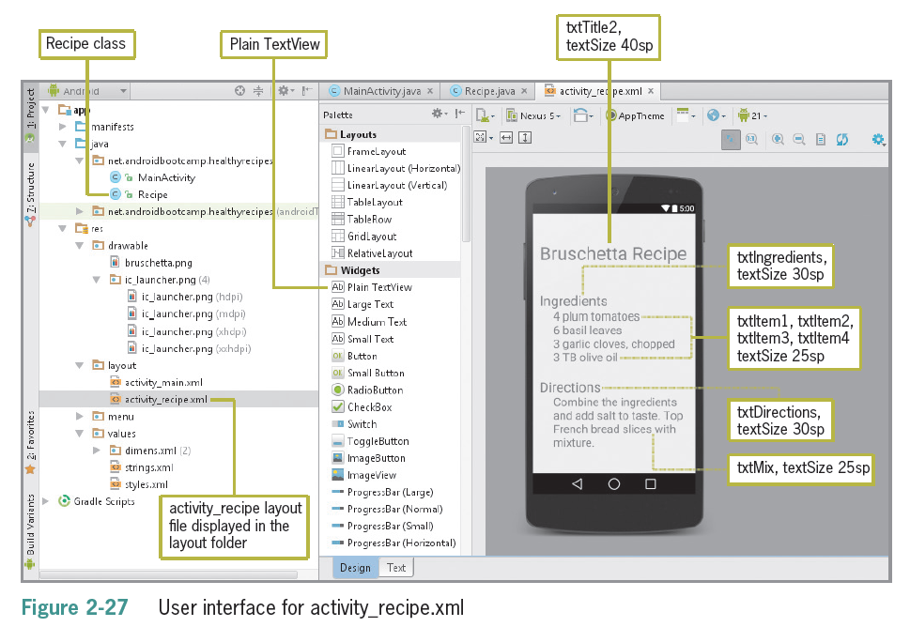
Creating Activities (continued)

Slide 36
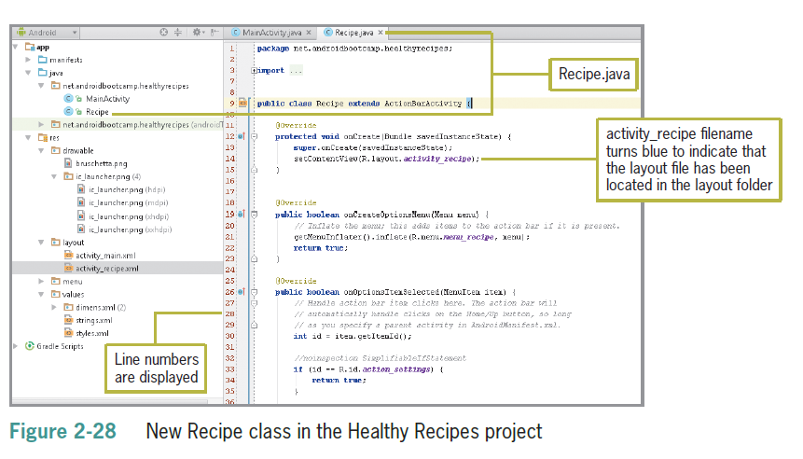
Creating Activities (continued)
Deprecated

Slide 37
The Android Manifest File
The Android Manifest file contains:
the name of the Java application
a listing of each activity
permissions needed to access other Android functions (like accessing the Internet)
the minimum level of the Android APL
Adding an Activity to the Android Manifest
When applications have more than one activity, the Manifest must have an intent to navigate among multiple activities

Slide 38
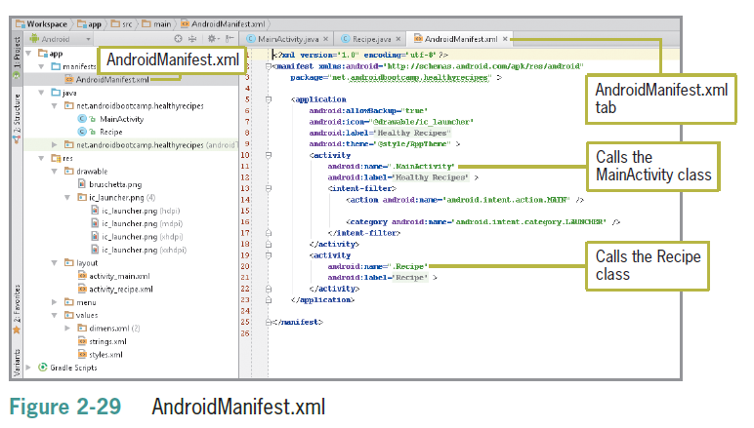
The Android Manifest File (continued)

Slide 39
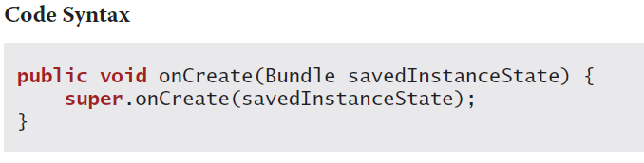
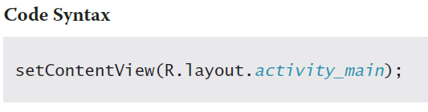
Coding the Java Activity
A method is a set of Java statements that can be included inside a Java class to perform specific tasks
The method body contains a collection of statements that defines what the method does.
Coding an onCreate Method
Requires corresponding setContentView Java code to display a specific screen

Slide 40
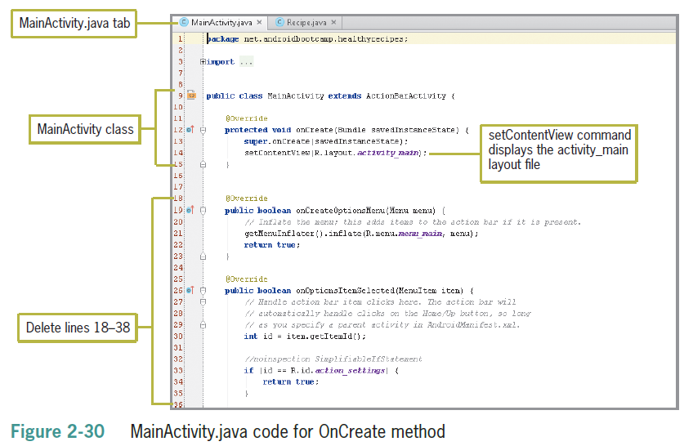
Coding the Java Activity (continued)
Displaying the User Interface

Slide 41
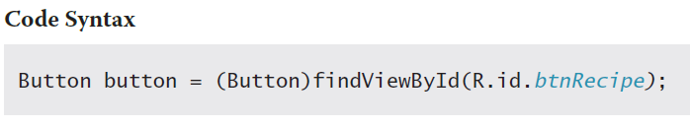
Coding the Java Activity (continued)
Creating a Button Event Handler
An event handler is part of a program coded to respond to a specific event
Tapping the button is called a click event
Java code must contain the following sections
Class property to hold a reference to the Button object
onClickListener() method to await the button click action
onClick() method to respond to the click event

Slide 42
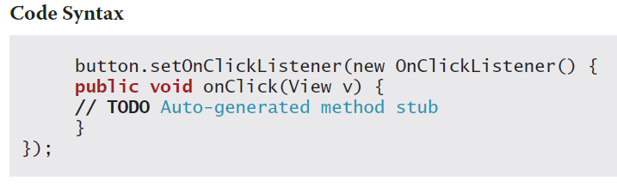
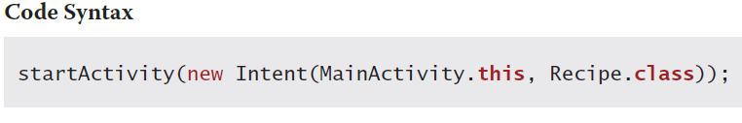
Coding the Java Activity (continued)
When you import the Button type as an Android widget, the button package becomes available throughout the app
An import statement makes more Java functions available to your app
A stub is a code placeholder module

Slide 43
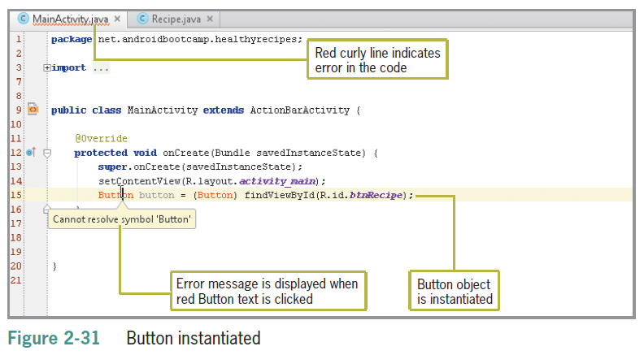
Coding a Button Event Handler

Slide 44
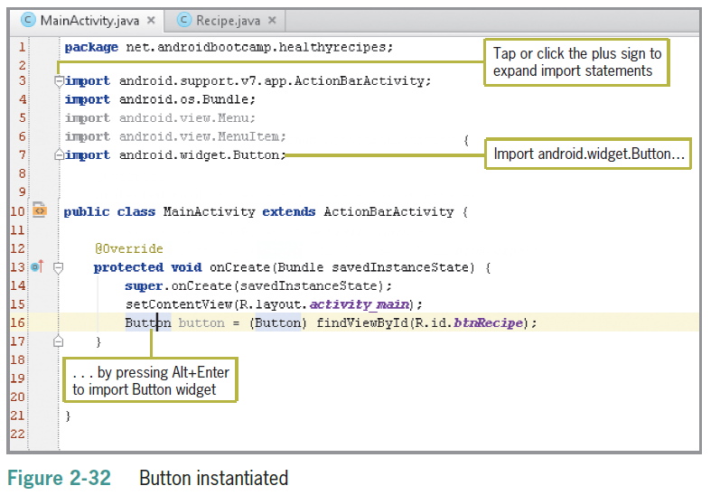
Coding a Button Event Handler (continued)

Slide 45
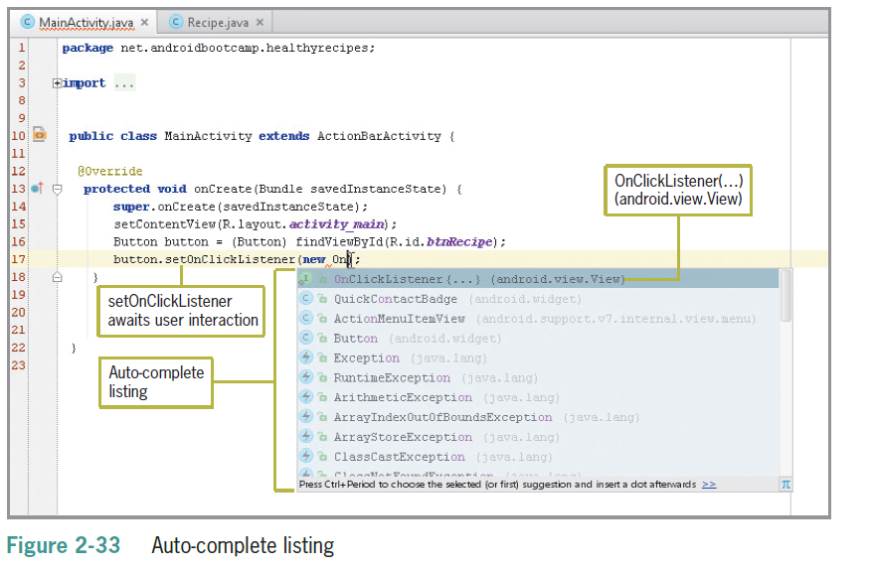
Coding a Button Event Handler (continued)

Slide 46
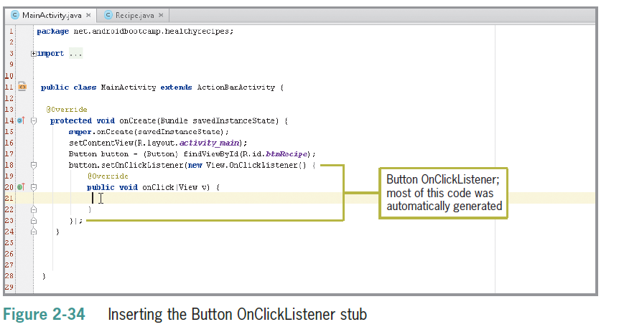
Coding a Button Event Handler (continued)

Slide 47
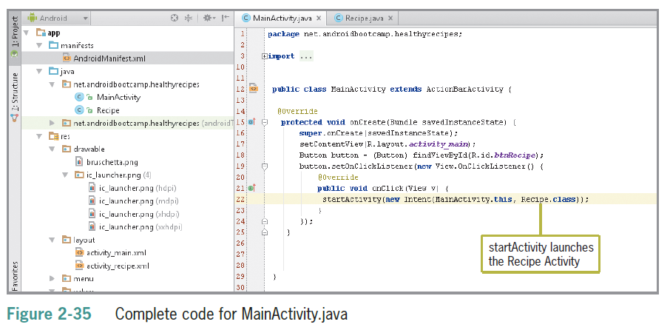
Coding a Button Event Handler (continued)

Slide 48
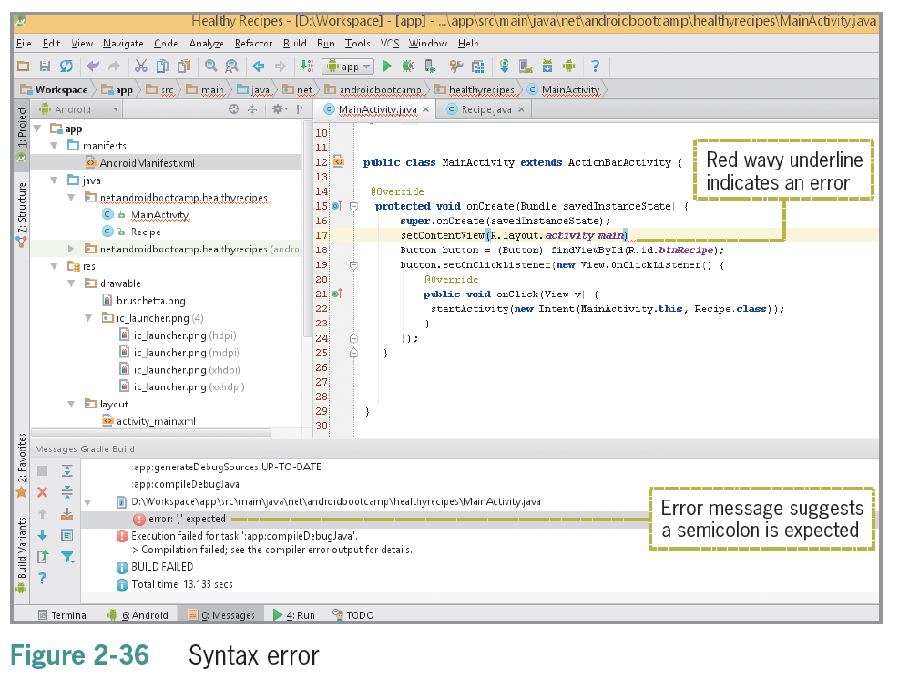
Correcting Errors in Code

Slide 49
Saving and Running the Application
Tap or click the Run ‘app’ button on the toolbar to test the application in the emulator
A dialog box opens the first time the application is executed requesting which emulator you would like to launch
Tap or click Launch emulator and select Nexus 5 API 21x86 or a similar emulator and tap or click the OK button
When the emulated Android main screen appears, unlock the emulator
Run the application again to send the code to the emulator. The application opens in the emulator window, where you can click the VIEW RECIPE button to view the bruschetta recipe

Slide 50
Summary
Instead of adding text directly to a control’s text property, you add it to the strings.xml file by working with the String table in the Translations Editor
Relative layouts arrange components freely on the screen
Popular text properties for controls include the text property, which specifies the string resource to use for displaying text in the control, and the textSize property, which specifies the size of the text

Slide 51
Summary (continued)
To display graphics (pictures and icons), use the ImageView control
An Activity is when the app makes contact with the user and is a core component of the app
Each screen in your app is an Activity
Every app has an Android Manifest file containing the name if the app and a list of each activity

Slide 52
Summary (continued)
A method is a set of Java statements that can be included inside a Java class. The onCreate method is where you initialize an Activity. You use the SetContentView command to display the content of a specific screen
When the user taps a Button control in an Android app, the code for an event listener, or click event, begins the event associated with the Button control. Event listeners such as the OnClickListener method wait for user interaction before executing the remaining code

Slide 53
Summary (continued)
In an Android app that contains more than one Activity, or screen, you use the startActivity( ) method to create an intent to start another Activity. The intent should contain two parameters:
A context and the name of the Activity being opened A context shows which initiating Activity class is making the request

Slide 54
Summary (continued)
When you run an Android application, a dialog box opens if your project contains any errors
Look for red error icons and red curly lines, which identify the location of the errors
Point to a red curly line to have Java suggest a correction

